Slide 1
2022
AGM

Slide 2
Welcome

Slide 3
Who are Trinity PFA?

Slide 4
We are a small team of volunteers comprising of parents & carers of children at Trinity.

Slide 5
Objectives
The objective of the PFA is to enrich our children’s school experience. We do this by fundraising though organising fun events for the children and grown ups, as well as creating a social network of members. We are so proud of our school and have a great time trying make it the best it can be. Trinity PFA Is a registered charity and we must abide by the Charity Commission’s Rules. PFA is run by a committee that is elected each year at the AGM. The AGM meeting is the only formal meeting of the year for the PFA and is one that deals with the formalities of committee elections, financial audits, reviews and plans for the future. A copy of the Constitution is available on request.

Slide 6
What have we been up to & what have we raised?

Slide 7
Hub Christmas Market
Summer Fair
£229.45
£462.04
Christmas Bingo
Easter Bingo
£39.10
£1774.68
Pre-loved Uniform
Donations
Amazon
Stamptastic
£9.63
£96.79
£153.30
£92
Jubilee Crafternoon
Christmas Fair
£7.49
Krispy Kreme
£992.39
Fun Fall
£42
-£65.68

Slide 8
We raised an amazing
Thank you!

Slide 9
So what have we done with the money

Slide 10
Y2 Trip to Stick Man
£660
£700
Y5 Trip to Lytham St Anns
Y1 Trip to Blackpool
Hoodies
£580
£91
Book Bags for Reception
Y6 Leavers Party
£2400
£1139.40
£477
£150
Shed
Y6 Leavers Books

Slide 11
Treasurers
Report

Slide 12
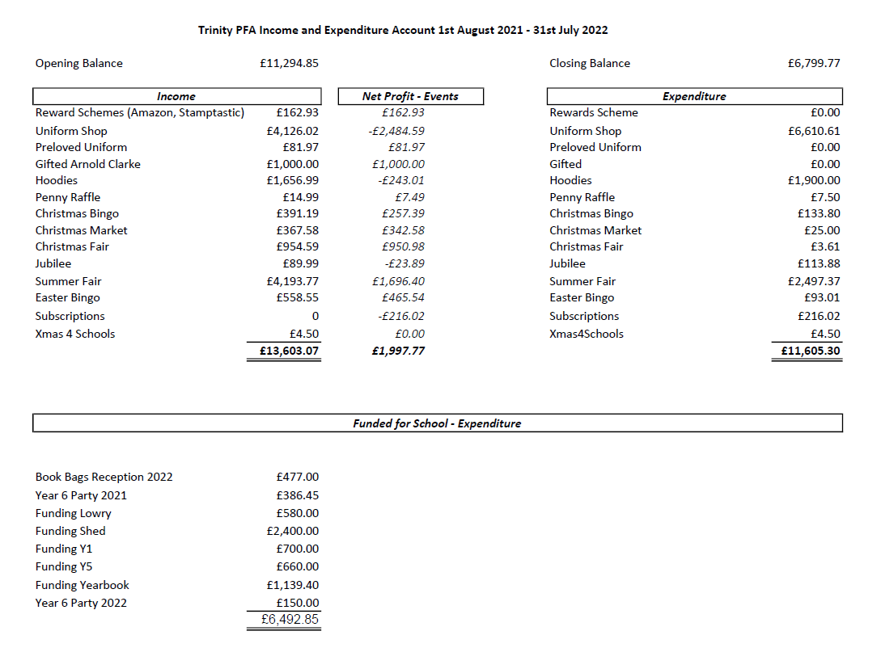

Slide 13
Election of officers
www.surveymonkey.co.uk/r/ZSVKDQH

