Slide 1

AGM
2023

Slide 2


Welcome

Slide 3

Who are Trinity PFA?

Slide 4
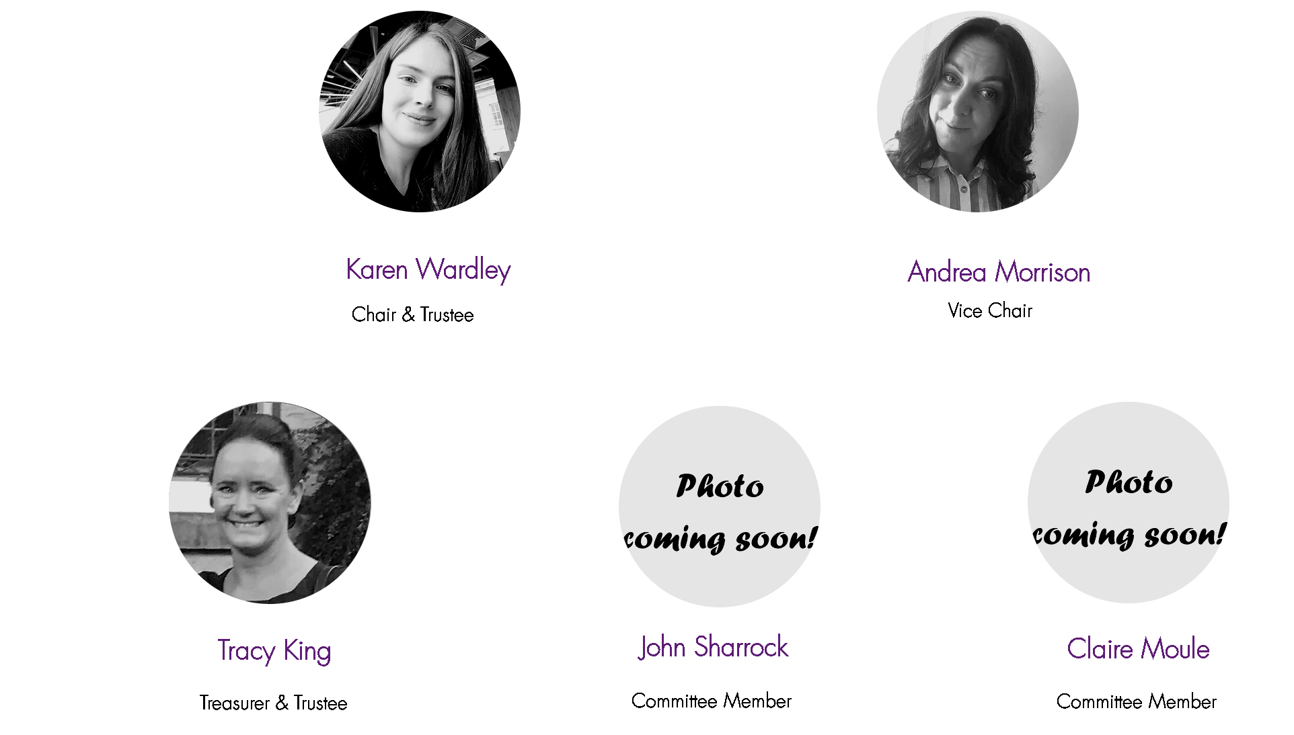
We are a small team of volunteers comprising of
parents & carers of children at Trinity.

Slide 5
Objectives
The objective of the PFA is to enrich our children’s school experience. We do this by fundraising though organising fun events for the children and grown ups, as well as creating a social network of members. We are so proud of our school and have a great time trying make it the best it can be.
Trinity PFA Is a registered charity and we must abide by the Charity Commission’s Rules. PFA is run by a committee that is elected each year at the AGM. The AGM meeting is the only formal meeting of the year for the PFA and is one that deals with the formalities of committee elections, financial audits, reviews and plans for the future. A copy of the Constitution is available on request.

Slide 6

What have we been up to & what have we raised?

Slide 7

Penny Raffle
Summer Fair
£416.46
£447.25
Christmas
Bingo
Easter Bingo
£16.06
£2,379
Pre-loved Uniform
Donations
Christmas Fair
Amazon
£196.99
£900
£2,326.88
£77.26
Autumn Disco
£739.93
Coronation Ball
£230.99

Slide 8

We raised an amazing
Thank you!

Slide 9

So what have we done with the money

Slide 10





Y6 Trip to Outdoor Elements
£1,342.80
Y6 Leavers Books
£2,115
Book Bags for Reception
£432.77
£383.91
£642.60
Y6 Leavers
Hoodies
Y6 Leavers Party

Slide 11


Treasurers
Report

Slide 12

Election of officers

Slide 13



Slide 14

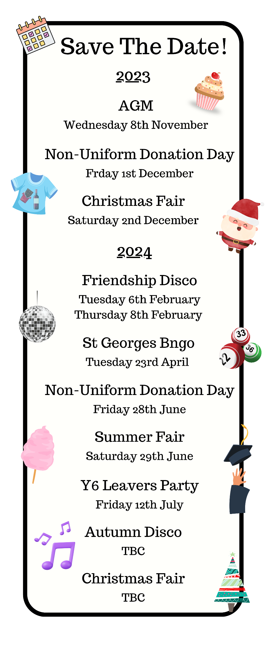
Upcoming
Events
2023 2024

